Slide 1
“Keeping Families on the Farm”

Slide 2
Three Topics to Consider
Consolidation
FamilyFarms Group
A New Ag Concept: Coming Together to Feed the World

Slide 3
Trends in
Agriculture Today

Slide 4
Trends in Row Crop Agriculture
- Decline in the number of farms
- Increase in average farm size
- Fewer and fewer people living on farms
Fewer young people coming back to the farm
Increasing average age of farmers
Increased use of technology
Increased need for business management skills
Progression from local to national to global focus

Slide 5
Consolidation: Threat or Opportunity?

Slide 6
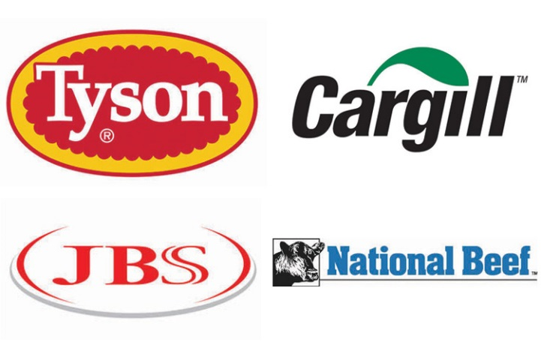
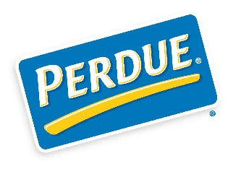
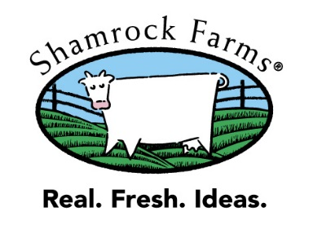
Let’s look at the other sectors:
Poultry
Dairy
Pork
Beef

Slide 7
Poultry = Complete Consolidation
The USDA does not even recognize independent producers as part of the poultry production landscape anymore – only as a part of the integrated production process of the large companies.
In the last 50 years, the number of farms in poultry production has decreased by…….98%.
One in every 4 chickens is a Tyson chicken.
Poultry farmers were squeezed out by consolidation in the processor market, to the point that the processors set the prices and forced the independent growers into their model.
Poultry Production
Source: USDA, ERS

Slide 8
Beef - “Get big or get out”
Percentage of Feedlot Production
Largest 2.47% of feedlots produce 85% of the beef.
The five largest feed lots (.0007%) produce 20% of the entire US capacity.
The amount of cattle that JBS directly produces annually, would be the row crop market share equivalent of 25,600,000 farm acres.
90% are part time with less than 100 cows, and they all sell 4 processors (that are also the 4 largest direct producers).
Fun fact…..nearly 30% of all slaughtered beef in the US is now owned by a Brazilian company.
Source: USDA-NASS 2011, Food and Water Watch

Slide 9
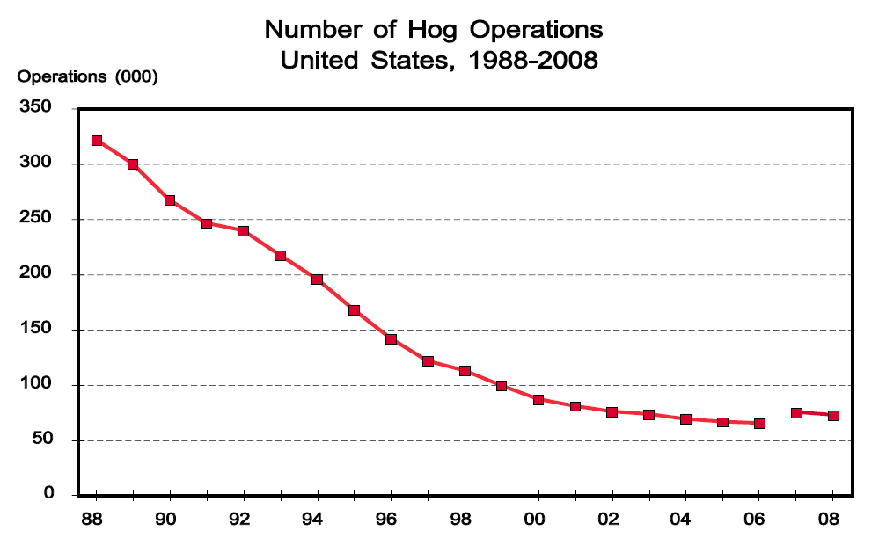
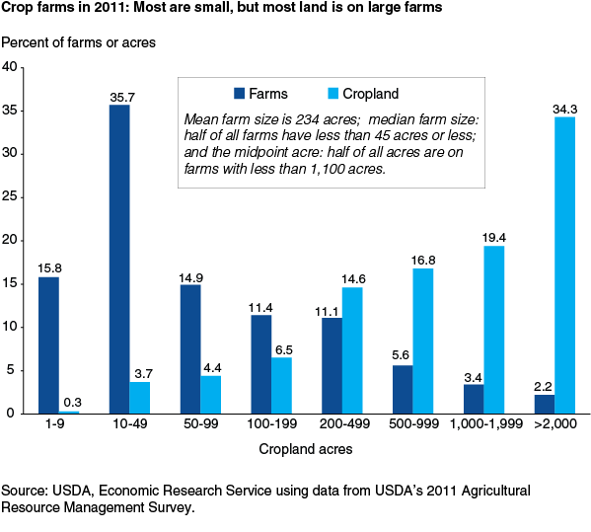
So..... what about crops?
Poultry Production
Beef Feedlot Producers

Slide 10
Macro Factors Driving Row Crop Consolidation
Age
Technology
Capital
Economics
Inability (or lack of desire) to see and envision how the crop industry can and will change

Slide 11
2012 USDA Farm Size Data
Annual Revenue | Percent of Farms | Revenue Percent
Less than $500,000 | 92.6% | 19.7%
$500,000 - $1M | 3.6% | 13.9%
$1M - $2.5M | 2.7% | 22.3%
$2.5M - $5M | 0.7% | 12.4%
$5M up (8,565 farms) | 0.4% | 31.7%
The Smallest 92.6% of Producers Represent 19.7% of the Market
The Largest 1.1% of Producers Represent 44% of the Market

Slide 12
“Unless an organization is changing on the inside as fast as the industry is changing on the outside, the end is in sight.” - Jack Welch, former CEO of General Electric

Slide 13
About FamilyFarms Group /
AgriSolutions

Slide 14
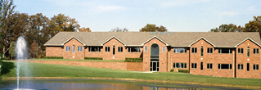
AgriSolutions Inc. Overview
48 years of service to agriculture
Hundreds of clients across 22 states
Clients represent more than 1 million acres
Purpose is to enhance business skills of producers
31832 Delhi Rd., Brighton, IL

Slide 15
FamilyFarms Group Overview
Launched in 2007
Operations in 16 U.S. states & 4 Canadian provinces
Purpose is to enhance sustainability in order to “Keep Families on the Farm”
Over 500,000 acres in total – the largest row crop organization in North America
Helping farm families gain business skills – Offering professional consultants in more than 22 business areas
31832 Delhi Rd., Brighton, IL

Slide 16
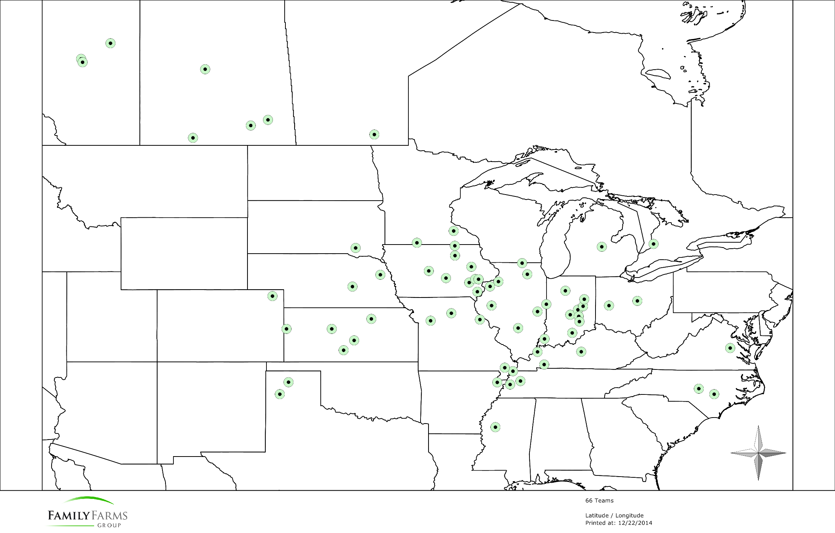

Slide 17
Intro
Consolidation
International Competition
Choosing A “System”
Benefits
Conclusion

Slide 18
Intro
Consolidation
International Competition
Choosing A “System”
Benefits
Conclusion

Slide 20
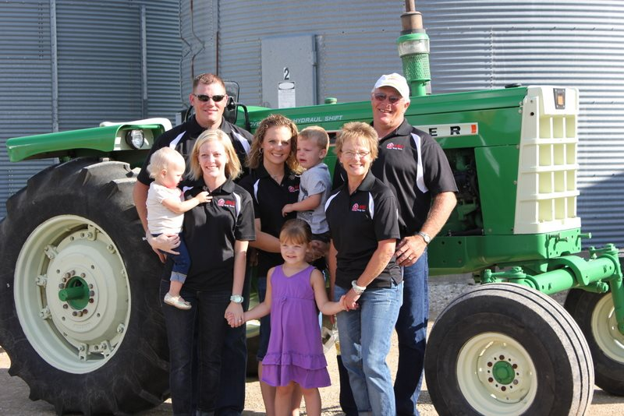
The Family Farms Group System: Resources you need - when you need them
Technology Software
Precision Ag Support
Generational
Transitions
Hardware Installation
Grants
Establish Goals
Business Evaluation
Political Influence
Capital Access
Landowner Relations
Business Marketing
Human
Resources
Acreage Growth
Time Management
Peer Groups
Operations Management
Role Definement
Employee Recruitment
Cost Reduction
Training
Personnel Recruitment
Grain Marketing
Benchmarking
Operational Efficiency
Accountability
To Implement
Legal Assistance
FFG Charities
Enhance Revenue
Safety Training
SOP’s
Risk Management
Finance

Slide 21
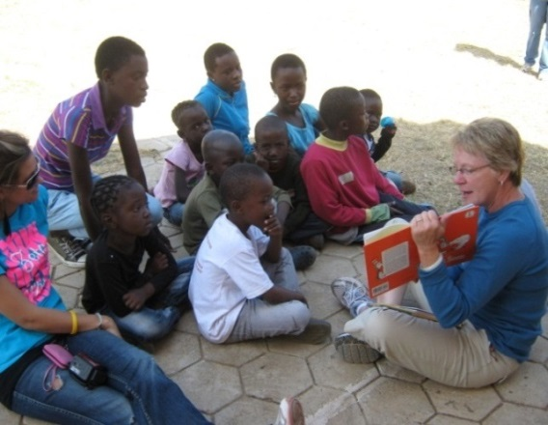
Support of Bethesda AIDS Orphanage in South Africa – garden and greenhouse
Scholarships for college ag students
Donations to U.S. 4-H and Canadian 4-H
Donations of food to Feeding America and Arkansas Rice Depot
Banana orchards and wells for villages in Kenya
Farm animals /clothing to foster self-sufficiency in families and communities world-wide
Volunteering in soup kitchen, food banks
Packing disaster kits
Supporting Jackie Joyner-Kersee urban ag
hands-on educational garden project

Slide 22
A New Ag Concept:
Coming Together to
Feed the World

Slide 23
U.S. Ag Exports 1990-2010
Year | Trade Balance | Exports, domestic products | % of All Exports
1990 | $16.6 | $39.5 | 11
1995 | $26.0 | $56.3 | 10
1999 | $10.7 | $48.4 | 8
2000 | $12.3 | $51.3 | 7
2001 | $14.3 | $53.7 | 8
2002 | $11.2 | $53.1 | 8
2003 | $12.0 | $59.4 | 9
2004 | $7.4 | $61.4 | 8
2005 | $3.9 | $63.2 | 8
2006 | $5.6 | $70.9 | 8
2007 | 18.1 | $90.0 | 9
2008 | 34.3 | $114.8 | 10
2009 | 26.8 | $98.5 | 11
2010 | 33.9 | $115.8 | 10
(In Billions of dollars)
Source: U.S. Department of Agriculture, Economic Research Service

Slide 24
A Growing Polarization
Ag producers recognize the need for larger farms, higher yields, more efficient equipment… to meet the food and fiber needs of a growing world population.
BUT…
All consumers want healthy and safe food, and some demand it also be locally grown.
Large vs. Small
Organic vs. Traditional
GMO vs. Non-GMO
So what is the answer? How can both be achieved?

Slide 25
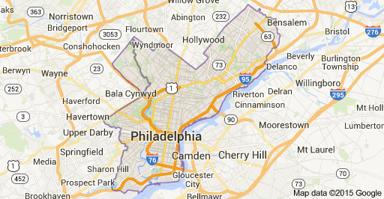
The Concept We’re Proposing
Land within the circle will receive special tax incentives to grow food for local consumption.
Land outside the circle will be oriented to crops for ethanol, export, animal feed, etc. – those where volume and efficiency are more important.

Slide 26
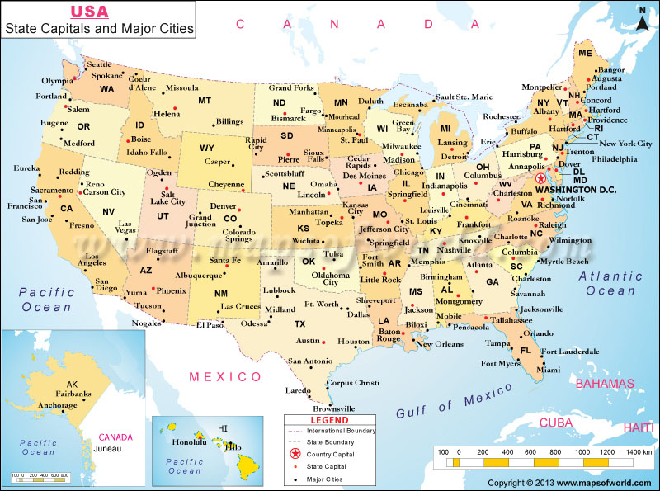

Slide 27
USDA’s Corn Projections
(In million bushels)
USE | 2013/14 | 2024/25
Feed & residual | 5,132 | 5,925
Ethanol and by-products | 5,134 | 5,200
Exports | 1,917 | 2,500
Food, seed & industrial | 1,363 | 1,495
Total Use | 13,546 | 15,120
Source: USDA, 2/11/15

Slide 28
What can FFG do?
FamilyFarms Group is moving forward, expanding and taking advantage of exciting opportunities to help farm families build value and leave a valuable legacy for succeeding generations.
While our producers are large family operations, we would support and endorse this concept by helping small producers in various ways:
Do tillage work for them
Rent them land
Provide them with competitive advantages
By focusing on our common objectives to provide people with food and fiber, and making it available in the right places at the right times, together large and small producers can meet the needs of our planet.

Slide 29
Possible Issues
Implications to landowners (benefits)
Regulatory assurance/protection
Funding/tax incentives (federal or state)
Food safety issues
Local, state or federal initiative?
Long-term transition period
Title for this program
Who would be the champion to get the program established and ensure successful completion?

Slide 30
What can YOU do?
Is this issue worthy of your attention?
Is this the kind of initiative that would interest PSPA, our nation’s first ag club?
Would you be willing to support this concept through
Leadership
Intellectual contributions
Relationships/contacts

Slide 31
Questions?
Consolidation
FamilyFarms Group
A New Ag Concept: Coming Together to Feed the World

Slide 32
Preserve Our Legacy of Family Farming
Working Together
to

