Slide 1
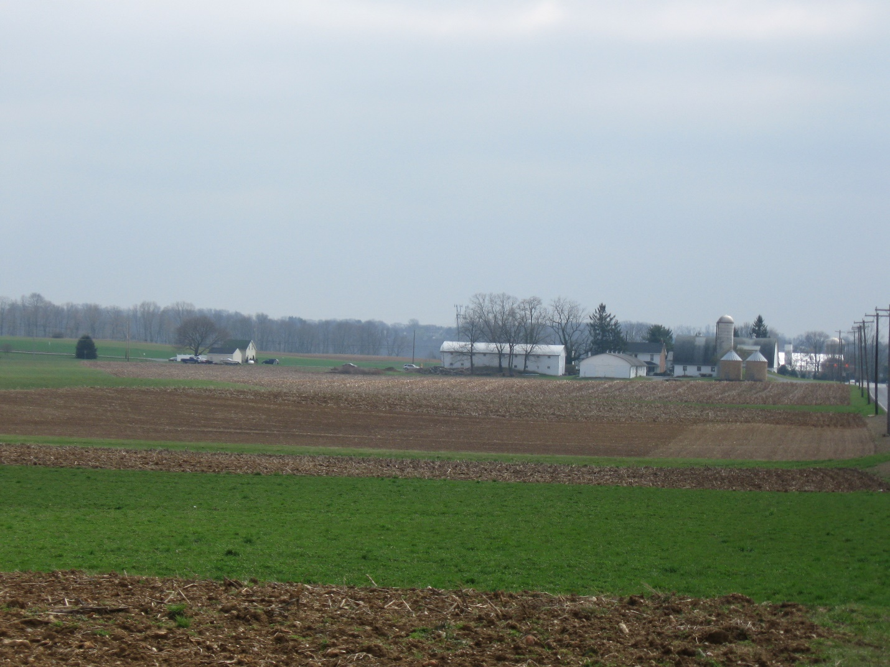
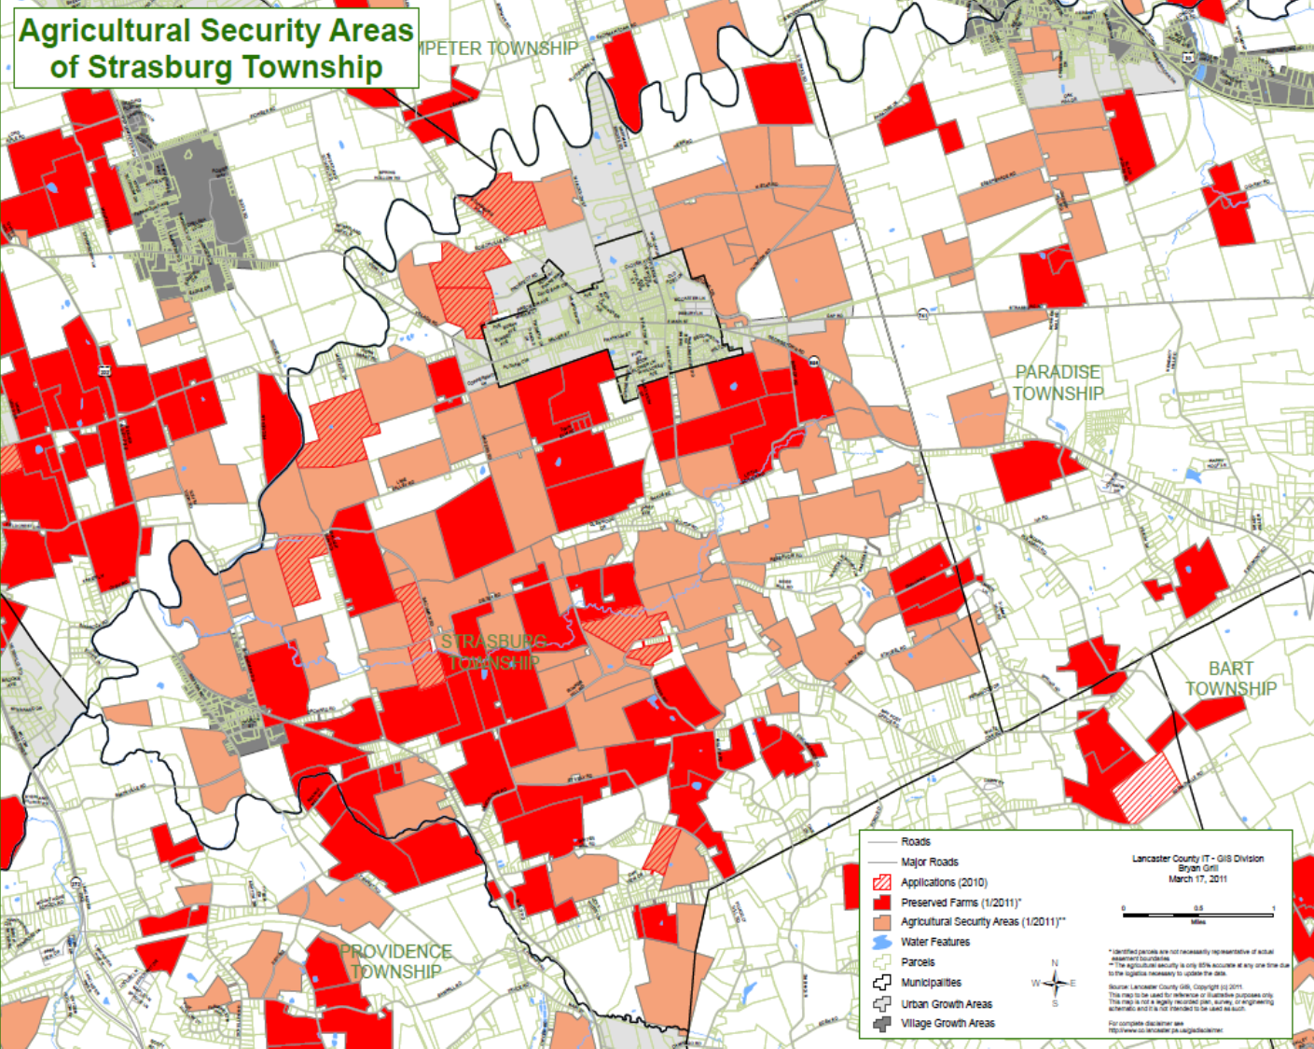
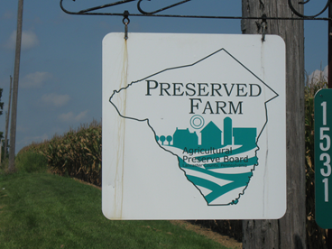
Preferred Patterns for Farmland Preservation
Professor Tom Daniels
Philadelphia society for promoting
agriculture
November 1, 2018

Slide 2
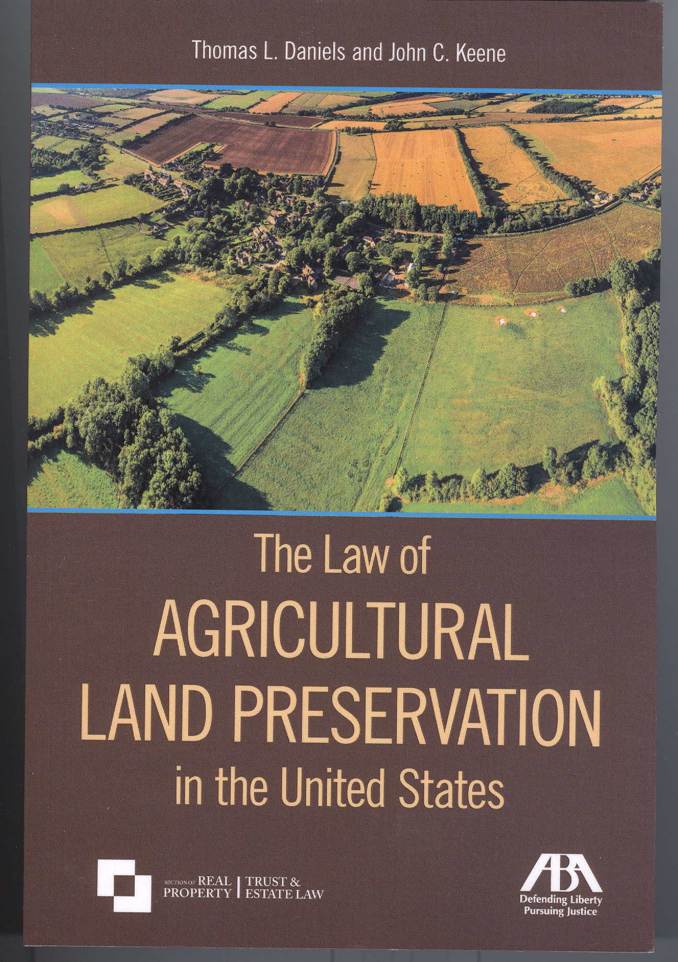

Slide 3
What is Farmland Preservation?
Let’s start with the bundle of landownership rights.

Slide 4
What is Farmland Preservation?
1. The purchase of a conservation easement by a land trust or government agency, or a donation of a conservation easement to a land trust or government agency, or a bargain sale.
2. The deed of easement spells out the restrictions on the use of the land.
3. The deed of easement is recorded at the county courthouse and runs with the land.
4. The large majority of conservation easements are perpetual. But the easement holder must monitor and enforce the terms of the easement.
5. A conservation easement is far more permanent than zoning.

Slide 5
What are the Goals of Farmland Preservation?
1. Get the farm to the next generation.
2. Protect productive soils for current and future use.
3. Provide a source of fresh local food for local consumers.
4. Preserve a critical mass of farms and farmland that enables the farm support businesses to thrive.
5. Manage growth in a community or county.
6. Preserve large contiguous blocks of farmland to maintain a positive local climate for farming and keep non-farm development at a distance.

Slide 6
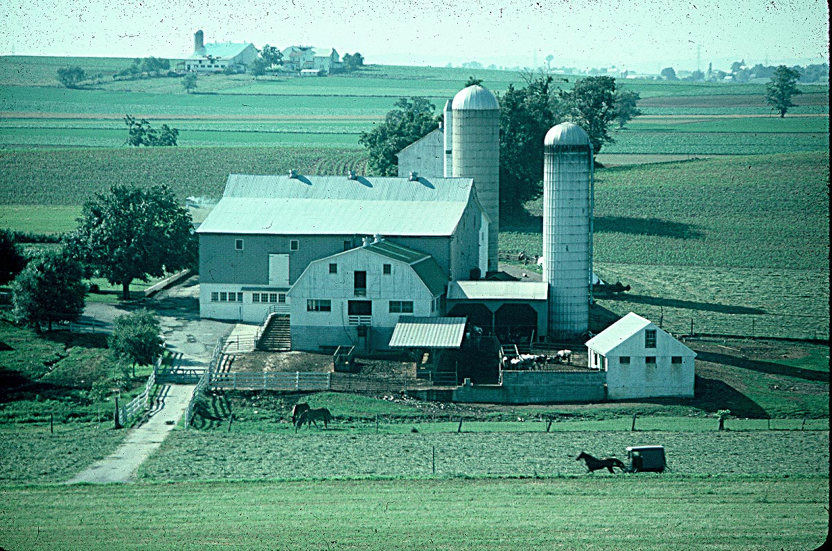
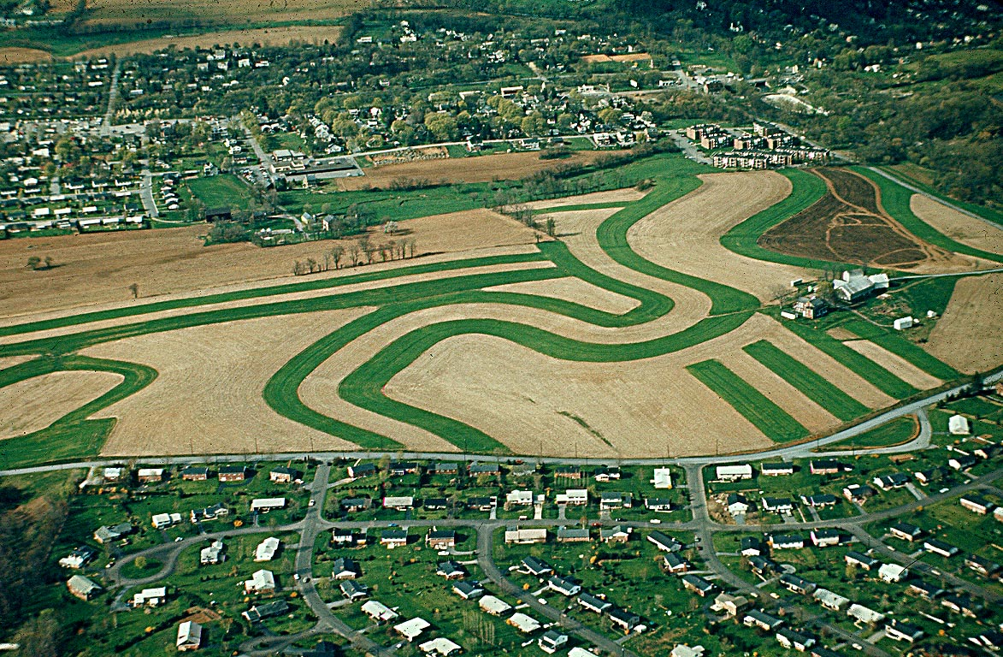
How to Select Which Land to Preserve?
Strategic or Opportunistic?

Slide 7
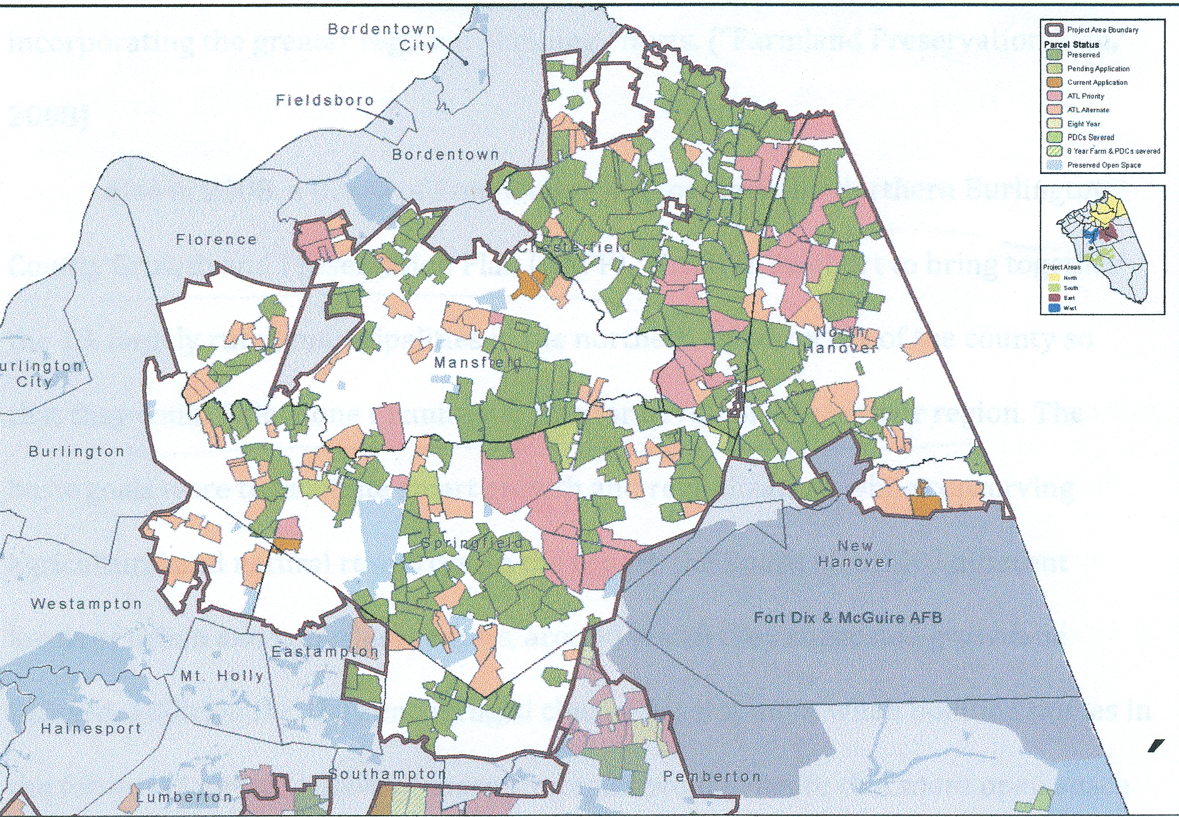
Northern Burlington County, NJ

Slide 9
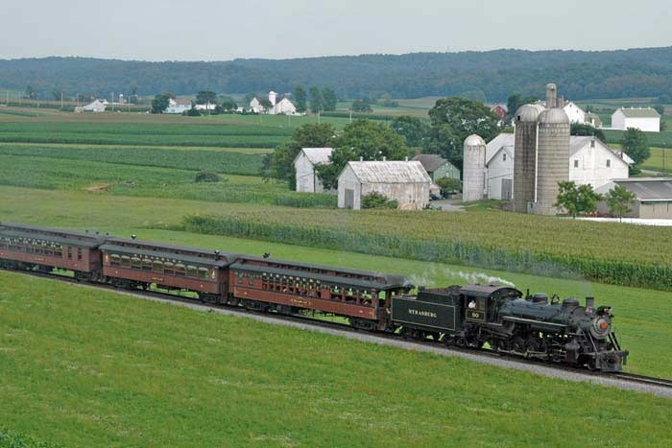

Slide 10
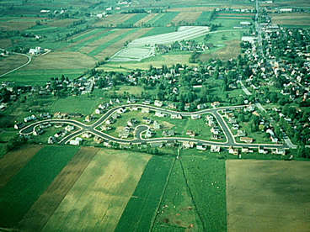
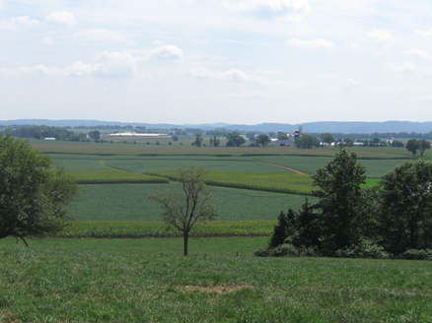
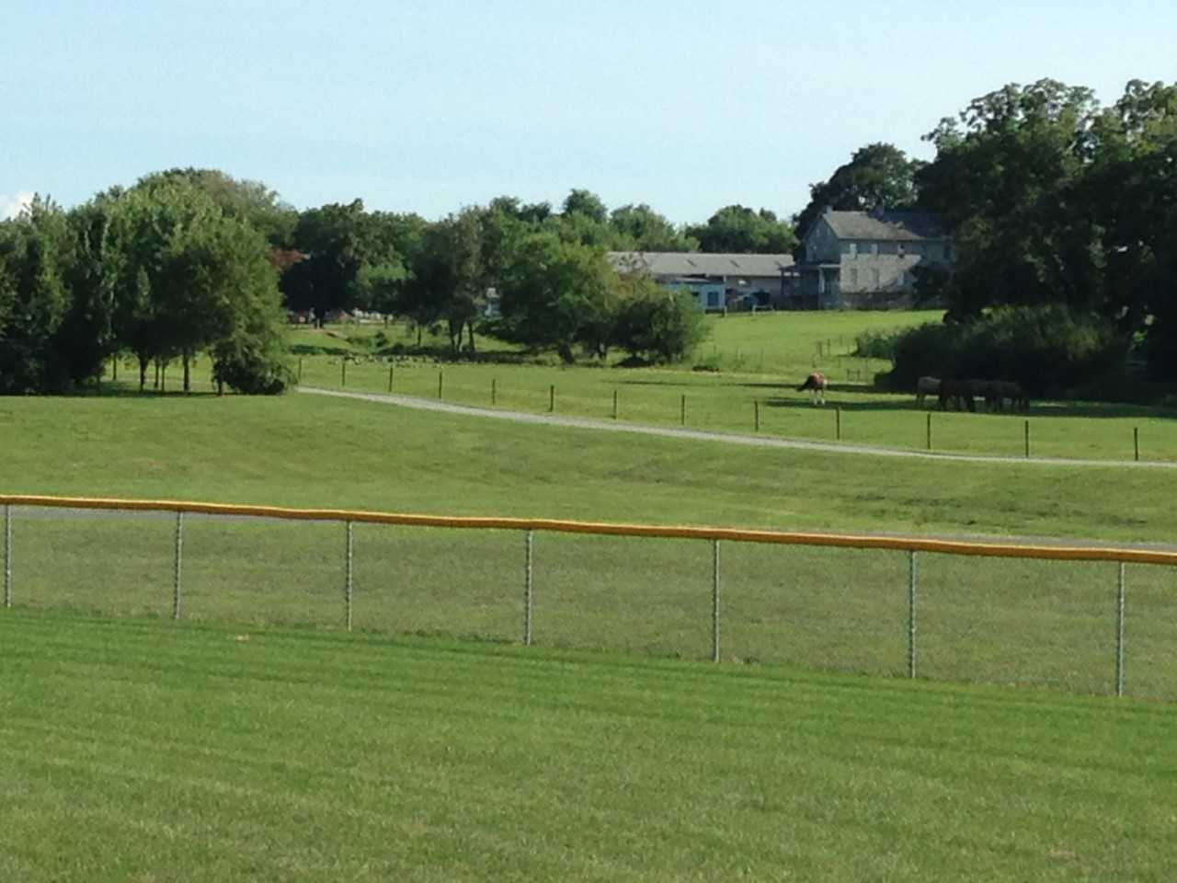
Three Possible Strategies
1. Preserve farms close to developed areas: create a line of preserved farms to limit the extension of sewer and water lines. Can be expensive.
2. Preserve farms well away from development. Stretch dollars and preserve as much farmland as possible. May not help manage growth.
3. Preserve farms under medium development pressure.

Slide 11
The Modified LESA System
LESA = Land Evaluation and Site Assessment
2 parts: Land Evaluation = Land quality
Site Assessment = Development pressure
An objective, flexible points-based system to:
a) determine if a parcel of farmland is worth preserving; and
b) rank prospective farms for the order in which to conduct appraisals of easement value

Slide 12
Factors and Points
Land Evaluation 50% of total points
Factor: Size of Farm
5 points maximum
20-49.9 acres 2 points
50-99.9 acres 3 points
More than 100 acres 5 points

Slide 13
More Land Evaluation
Factor: Soil quality 40 points maximum
50% or more Class I-III 10
50% - 74.9% Class I and II 20
75% or more Class I and II 40
Factor: Farm Revenue 5 points maximum
$25,000-$49,999 2
$50,000-$99,999 3
$100,000 and above 5

Slide 14
Site Assessment 50% of total points
Factor: Zoning 10 points maximum
Non-farm zoning 0
Rural residential zoning 5
Effective agricultural zoning 10
Factor: Road Frontage 10 points maximum
Less than 500 feet 0
500-999 feet 5
1,000-1,999 feet 7
2,000 feet or more 10

Slide 15
More Site Assessment
Factor: Distance to central sewer or water 20 points Maximum
Less than ¼ mile 0
¼-1/2 mile 5
½-1 mile 10
More than 1 mile 20
Factor: Proximity to a preserved farm 10 points maximum
Adjacent 10
Within ¼ mile 7
¼ to ½ mile 5
Beyond ½ mile 0

Slide 16
LESA: Example 1
80 acre farm, 50% Class I+II soils
$50,000 a year in sales: LE score: 26
Zoned for AG, 1,000 feet of road frontage,
2 miles from central sewer/water, ¼ mile from a preserved farm. SA score: 44
TOTAL SCORE: 70
What is the minimum accepted score?
E.g. 60 points

Slide 17
LESA: Example 2
200 acre farm, 50% Class I+II soils,
More than $100,000: LE score = 30
Rural residential zoning, more than 2,000 feet of road frontage, more than 1 mile from central sewer/water, adjacent to a preserved farm: SA score = 45
TOTAL SCORE = 75

Slide 18
Three techniques: 1) Agricultural zoning (in green); 2) Urban growth areas (in gray); and 3) purchase and donation of conservation easements (in red).

Slide 19
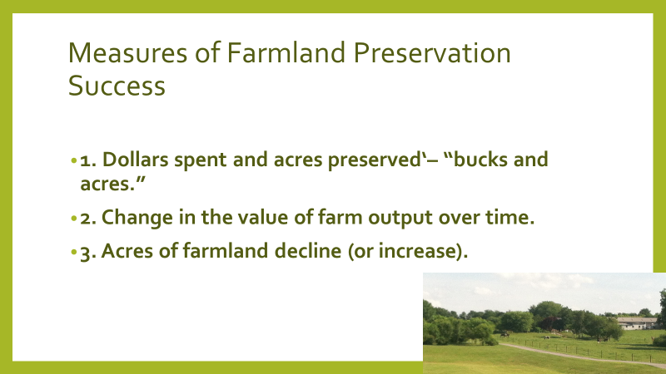

Slide 20
A New Measure of Farmland Preservation Success
The preservation of farmland in large contiguous blocks.
The change in contiguous blocks between 2007 and 2016 in Lancaster County

Slide 21
Contiguous and Stand Alone Farms by Acreage, 2007
Farm Blocks in Acres | Number of Blocks | Acreage in Block
TOTAL | 339 | 71,910
Contiguous Blocks | 231 | 65,743
1,000 acres | 9 | 20,927
500-999 acres | 18 | 12,112
250-499 acres | 37 | 13,039
Less than 250 acres | 167 | 25,832
Stand Alone Parcels | 108 | 6,167
Within 1/2 Mile of a Contiguous Block | 76 | 4,382
Beyond 1/2 Mile of a Contiguous Block | 32 | 1,785

Slide 22
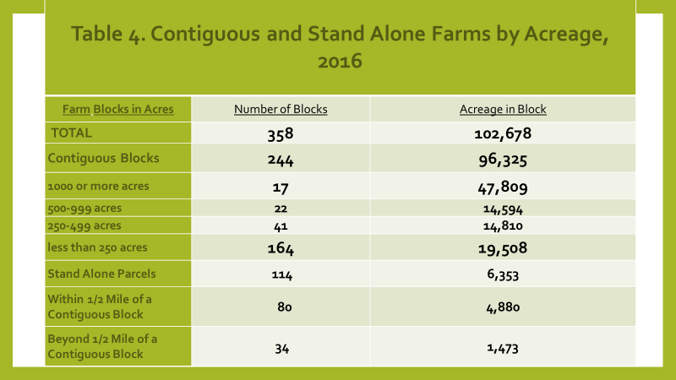

Slide 23
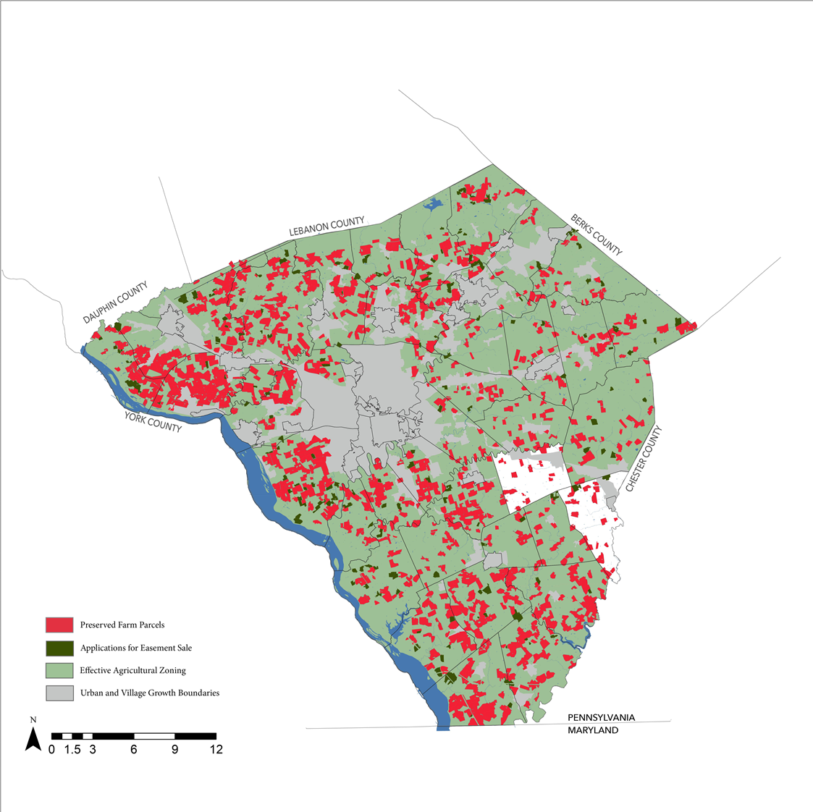
Pending easement sale applications (in green). Which farms to give the highest priority?

Slide 24
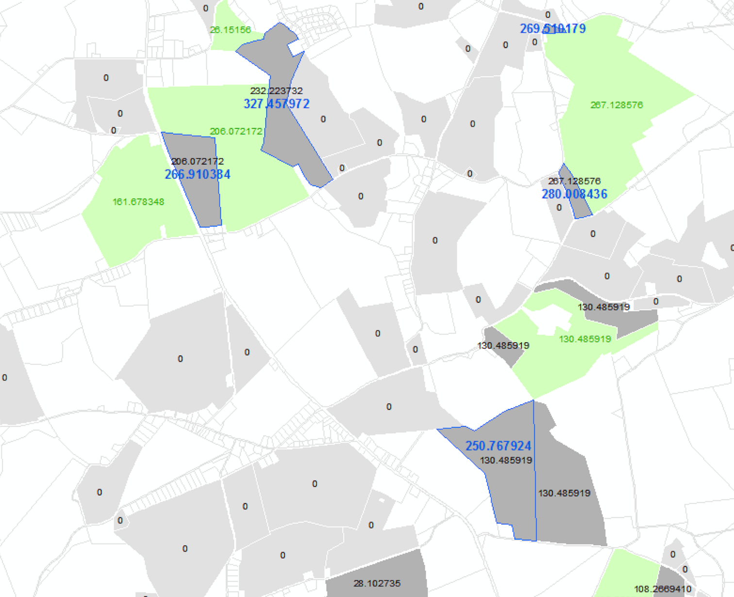
Creating larger blocks: Target Parcels in Gray.
Parcels in green are already preserved. Parcels in gray, if preserved, would create blocks of preserved farmland greater than 250 acres.

Slide 26
10,000+ acre block of preserved farmland
(in dark red)

