Slide 1
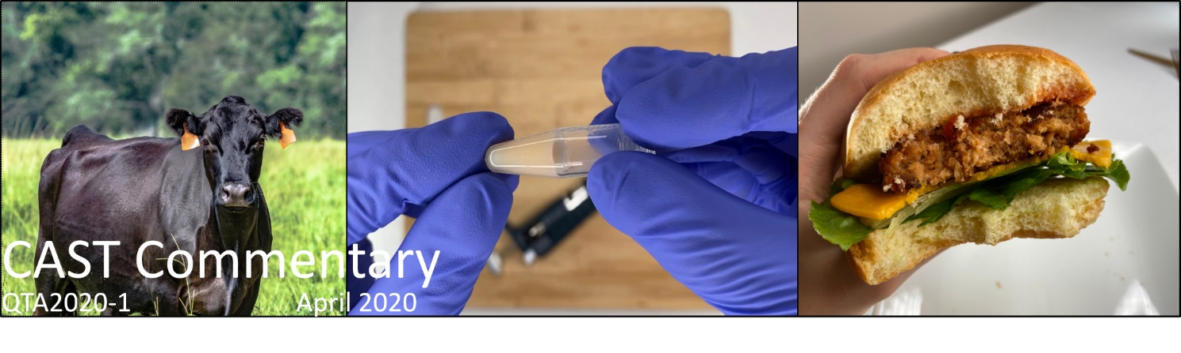

Producing Food Products from Cultured Animal Tissues
CAST Commentary QTA2020-1
Presented by
Anna Dilger, Ph.D.
Associate Professor, University of Illinois at Urbana-Champaign
April 28, 2020
#CASTreports2020

Slide 2
Task Force Members
Authors:
Dustin Boler (Chair)
  University of Illinois at Urbana-Champaign
  Min-ho Kim
  Kent State University
  Jess Krieger
  Kent State University
  Jennifer Martin
  Colorado State University
  Andrew Milkowski
  University of Wisconsin-Madison
  Paul Mozdziak
  North Carolina State University
  Brian P. Sylvester
  Foley & Lardner LLP, Washington, D.C.
Reviewers:
Jimmy Keeton
Texas A&M University
Jayson Lusk
Purdue University
Neil Stephens
Brunel University, London, United Kingdom
Liaison:
Anna Dilger
  University of Illinois at Urbana-Champaign
#CASTreports2020

Slide 3
Goal of Commentary
Identify challenges and uncertainties regarding the eventual production, sale, regulation, and safety of food products produced from cultured animal cells and tissues
Questions included:
  What techniques will be used to make these products?
  What types of products are expected to be available?
  Who will be responsible for regulating these products? How will they do that?
  How will these products be labeled?
  What food safety risks exist with these products?

Slide 4
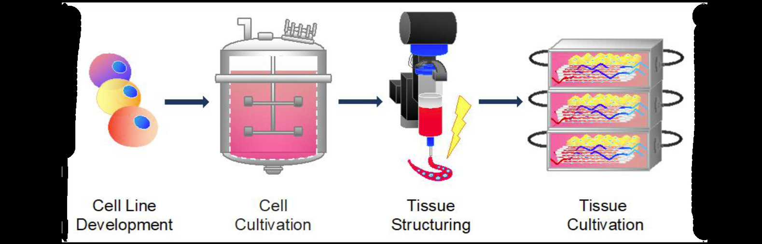
  What techniques will be used to make these products?

Slide 5
  What techniques will be used to make these products?
Many potential sources of cells:
  Biopsies from living animals
  Embryonic stem cells
  Bone marrow or other inducible stem cells
Current targets are mainly muscle cells and adipocytes as these are the main cell types in conventional meat
To culture tissues, other cell types might be needed
Cells must grow, divide, and mature in culture

Slide 6
  What techniques will be used to make these products?
Once suitable cell lines are developed, they must be cultured at a large scale
This means moving from well-established benchtop techniques of milliliters or a few liters at a time to thousands or tens of thousand liters in bioreactors
This requires a very large volume of cell culture media
  Media contains nutrients to “feed” the cells and growth factors and hormones to direct their growth, division, and differentiation

Slide 7
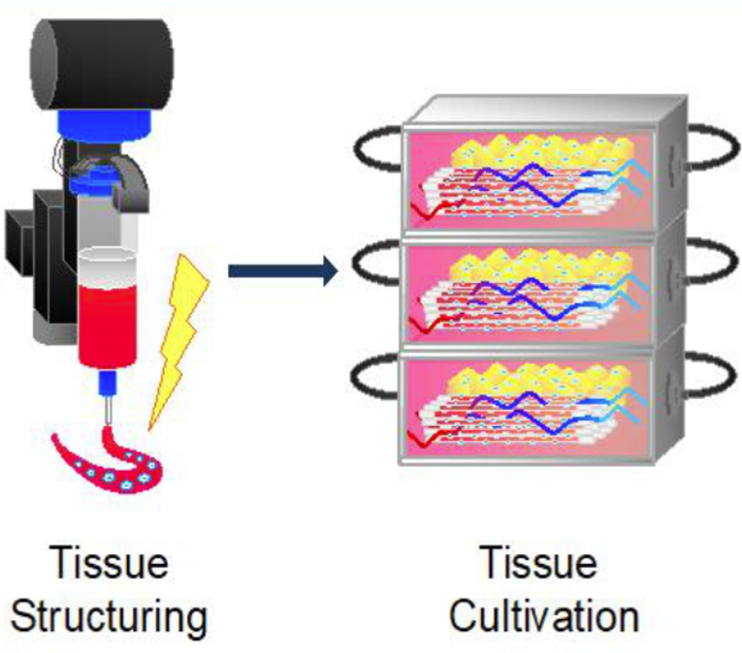
  What techniques will be used to make these products?
Cultivation of cells in bioreactors is only the first potential step of this process
  Several companies have or are rapidly attaining this stage of production
  This alone can lead to food products
The goal, however, is to completely mimic the texture, taste, and composition of traditional meat
  This will require culturing several cell types at once as tissues
Cells can be seeded into matrices of plant or animal origin and cultivated
This will require the development of technologies to accomplish this goal

Slide 8
Technical Challenges to Overcome
Selection and characterization of suitable cell lines
  Ease of propagation, nutritional content, palatability, or manufacturing traits
Lowering manufacturing costs
  This includes the costs of media components and bioreactor operation
Scaling up
  What works in a culture dish or few liters does not always translate to thousands of liters
Waste streams
  How will used media and other wastes be disposed of, recycled, or reused at scale
Development of allied industries and workforce

Slide 9
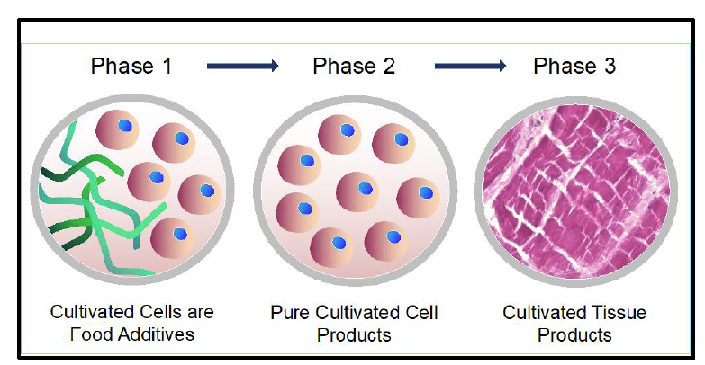
  What types of products are expected to be available?
Phase 1 Products | Phase 2 Products | Phase 3 Products
Cultivated cells would be used as an ingredient in a meat analogue of plant origin These cells would provide nutrients or flavor to the overall product | Products would be composed of entirely cultivated cells Likely would mimic current ground or formed products like hamburgers, sausages, or nuggets | Products would be cultivated tissues of many cell types Likely would mimic steaks, chops, roasts, or other “whole muscle” products
Soon Time Horizon for Products to be Introduced for Sale Much Later

Slide 10
  Who will be responsible for regulating these products?
  How will they do that?
FDA: Current Areas of Responsibility
USDA: Current Areas of Responsibility
Products that contain <3% raw meat or <2% cooked meat
Ingredients used in meat and poultry products like salt, phosphate, and curing agents
Veterinary products like drugs and devices
Livestock feed additives
Biologics, gene therapy products, tissue products
Safety of new technologies like genetic modification and cloning
Products that contain >3% raw meat or >2% cooked meat
  100% inspection of all animals and carcasses during the slaughter process
  Pre-approval of labeling
  Oversight of HACCP
Products containing cultivated cells span areas of FDA and USDA responsibility

Slide 11
  Who will be responsible for regulating these products?
  How will they do that?
In 2019, the USDA and the FDA formalized a Memorandum of Understanding outlining their planned cooperative approach toward regulation of these future products
Cell Collection and Cell Line Development
Cell and Tissue Propagation
Manufacturing of Products
Harvest of Cells/Tissues
FDA Responsible
USDA
Responsible
Established a working group to address:
  Pre-market assessment: FDA lead
  Transfer of jurisdiction
  Labeling: USDA lead

Slide 12
  Who will be responsible for regulating these products?
  How will they do that?
Expectation is that the USDA responsibility for regulation and oversight of final products will result in:
  HACCP plan and sanitation protocols similar to traditional meat processing
  Inspection of products and records
  Pre-approval of labeling
The USDA is also charged with developing additional requirements to ensure the safety and accuracy in labeling of human food products from cultured cells of livestock and poultry

Slide 13
  How will these products be labeled?
A large area of uncertainty because no products currently exist that need labeling
Meat product labels currently defined by standards of identity
  Consider origin of meat, additional of other ingredients, types of processing, nutritional composition
How will or can these definitions be expanded or altered to include products containing cultivated animal cells?

Slide 14
Hamburger
Cooked Ham
Breakfast Sausage
  CFR 319.15
  ‘‘Hamburger’’ shall consist of chopped fresh and/or frozen beef with or without the addition of beef fat as such and/or seasoning, shall not contain more than 30 percent fat, and shall not contain added water, phosphates, binders, or extenders.
  Classified based on Protein Fat Free
  >20.5% Ham
  18.5-20.5 Ham with Natural Juices
  17.0-18.5 Ham with Water Added
  CFR 319.143
  ‘‘Breakfast sausage’’ is sausage prepared with fresh and/or frozen meat; or fresh and/or frozen meat and meat byproducts, and may contain Mechanically Separated (Species) in accordance with §319.6, and may be seasoned with condimental substances as permitted in part 318 of this subchapter. The finished product shall not contain more than 50 percent fat. To facilitate chopping or mixing, water or ice may be used in an amount not to exceed 3 percent of the total ingredients used. Binders or extenders may be added as provided in §319.140 of this part.

Slide 15
Hamburger
Cooked Ham
Breakfast Sausage
  Would a product containing only cultivated cells from cattle be considered a hamburger because they are “beef” cells?
  Would the USDA require these hamburgers to be labeled differently denoting the source of cells?
  Would the source of pig cells need to be from a muscle considered typical for ham?
  Could pig muscle cells be added to ham in order to increase the protein fat free content?
  Does protein from pig cells “count” toward protein fat free?
  Will protein and fat derived from cultivated cells count towards nutritional standards?
  How will the concentration of restricted ingredients like nitrite or phosphate be calculated—with or without the weight of cells?

Slide 16
  What food safety risks exist with these products?
All foods for human consumption must be evaluated for potential biological, chemical, or physical hazards to food safety
Anticipated food safety risks for products containing cultivated animal cells or tissues are a mixture of familiar threats and novel ones
  Will cultivated cell products be safer than traditional meat?
Some have claimed that the lack of a slaughter environment will eliminate food safety risks in cell cultivated products
But these products will be at the same risk as traditional meat for contamination by adventitious organisms during processing and packaging

Slide 17
  What food safety risks exist with these products?
Potential Novel Food Safety Risks in Cultivated Animal Cell Products
Cell Lines | Contamination of cells during collection or contamination of cell banks
Cultivation of Cells | Reagents used in cultivation are not food-safe and may potentially leave residues in products | Is this similar to the risks of using veterinary products or food additives in traditional meat production?
Cultivation of Cells | Contamination within bioreactors | Is this similar to the risks of animal diseases present at slaughter?
Post-Harvest | Contamination during manufacturing | Likely analogous to concerns in traditional meat manufacturing
Post-Harvest | Presence of allergens

Slide 18
  Panel Discussion:
  Highlight of Some of the Questions
Food Safety
What steps are needed to design a food safety program for cultivated cell products?
Labeling and Regulations
How are current meat labeling practices regulated? How will this be extended to cultivated cell products?
Are there examples of FDA/USDA collaboration before?
Procedures and Challenges
What makes cultivated meat so costly? What efforts are being made to reduce costs?
What challenges need to be overcome to cultivate tissues and not just cells?
Do components of the media pose a food safety risk?

Slide 19
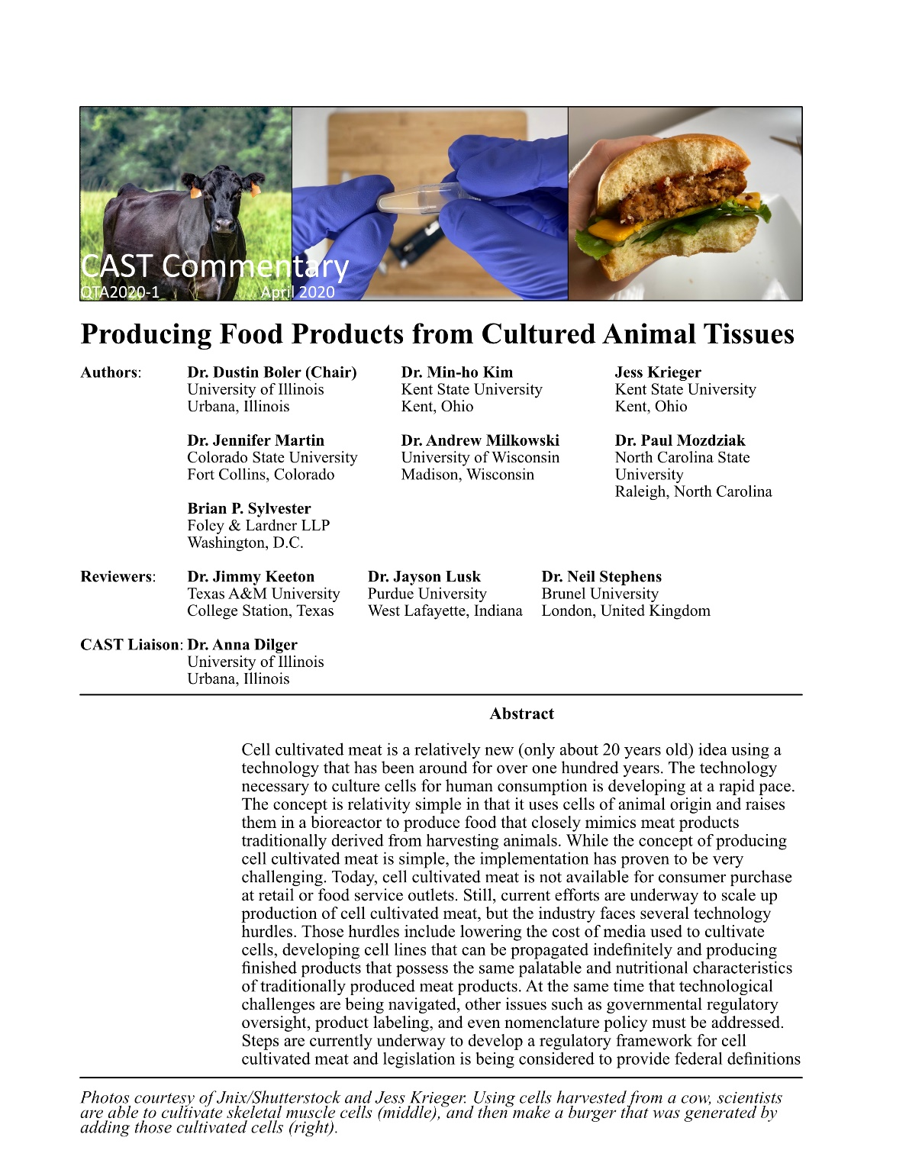
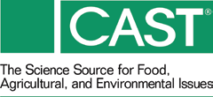
This CAST Commentary is available at
www.cast-science.org/
publications
Anna Dilger
adilger2@illinois.edu
#CASTreports2020

