Slide 1
Current state of
Pennsylvania’s dairy industry
Senator judy schwank
Pennsylvania Secretary of Agriculture, Russell redding
November, 2019

Slide 2
What We Will Cover Today:
Dairy’s Contributions to Pennsylvania
Landscape of Pennsylvania Dairy Industry
Challenges in the Supply Side
Changes in the Marketplace

Slide 3
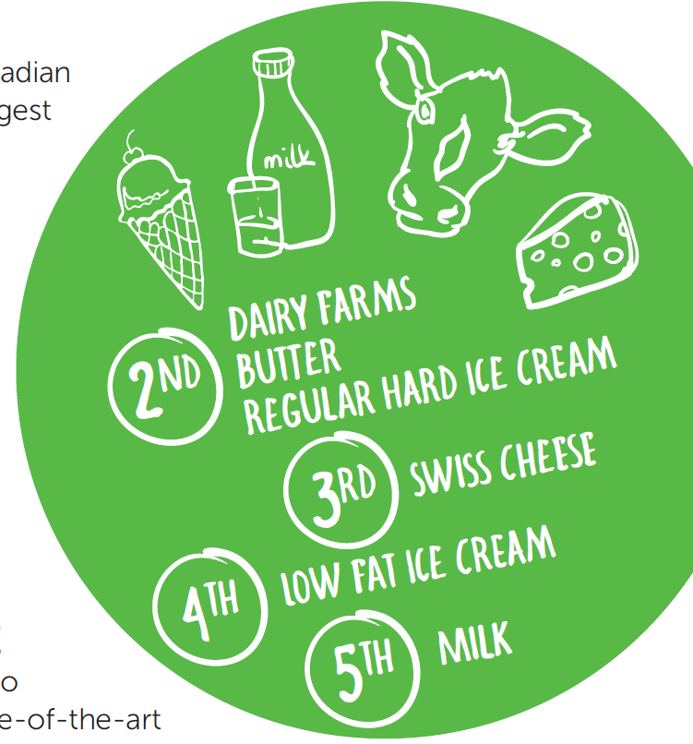
Pennsylvania national leader in dairy
Second Largest Number of Dairy Farms at 6,200 Farms
485,000 Head of Dairy Cows
Seventh Largest Industry in Total Milk Production YOY
Leader In:
  Butter
  Ice Cream
  Swiss Cheese
7TH

Slide 4
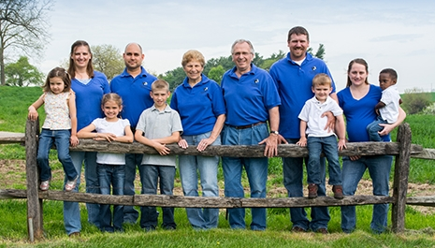
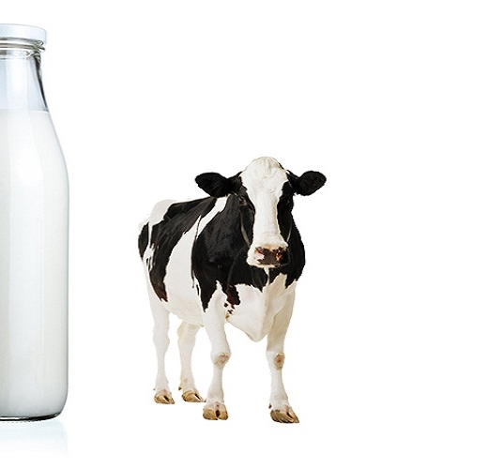
What Dairy’s Worth to Pennsylvania
10.715 Billion Pounds
of Milk Annually or
1.27 Billion Gallons
52,000 Jobs* Supported by Industry
A Local Abundant Source Of High Quality, Nutrient-rich Dairy Foods
Valuable Economic Revenue Generation
Local, Competitive Job Opportunities
Wide Open Spaces and Conservation of Our Natural Resources
Tourism Opportunities in Rural Communities
$14.7 Billion*
in Annual Economic
Revenue Generation
* From PA Dairy Study of 2015 Statistics.

Slide 5
Pennsylvania’s Milk Production Hit Hard in 2018-19
Pennsylvania’s Rolling 12-Month Average at 10.15 Billion Pounds in November 2019.
  Hit High of 10.97 Billion Pounds
  in February 2018
Falling Behind Nationally
  Minnesota Starting to Surpass Pennsylvania
  Michigan and Texas Surpassed Pennsylvania in 2017States
USDA Milk Production Report, November 2019

Slide 6
Pennsylvania milk production all from milk per cow, but slower per-cow growth than in other states

Slide 7
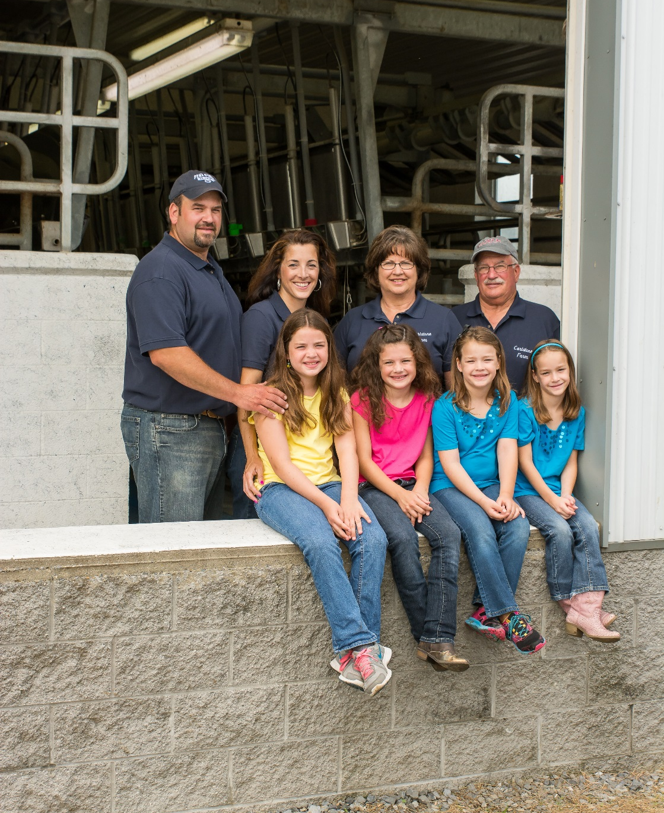
Changing demographics on Pennsylvania farms
State’s Dairy Herd Is Shrinking
  Down 40,000 Head Since February 2018,
  When Milk Production Peaked in State
  Now at 485,000 Dairy Cows in Pennsylvania
Milk Production Per Cow Improving, But Slowly
  Up 2.4 Percent from Year Ago
  Still 234 Pounds Below National Average
Herd Size is Growing
  80 Cows on Average Per Farm
  Still 150 Cows Below National Average of 230 Cows

Slide 8
Proportion of cows on farms, by size
From 2017 US Ag Census Data
Farm Size, By Milk Cows

Slide 9
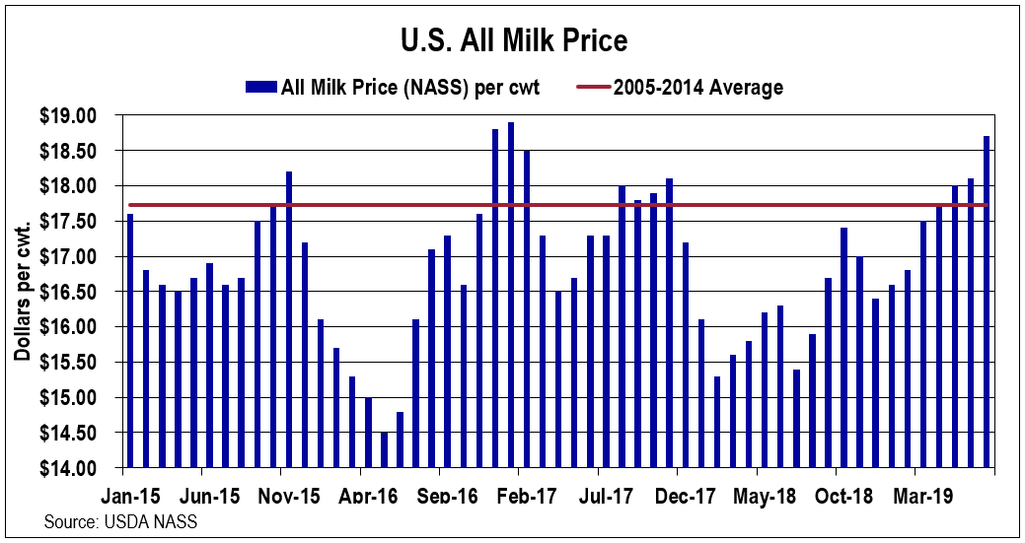
Average
Cost of Production on PA Dairy Farms
Average
Milk $
Over
15 Years

Slide 10
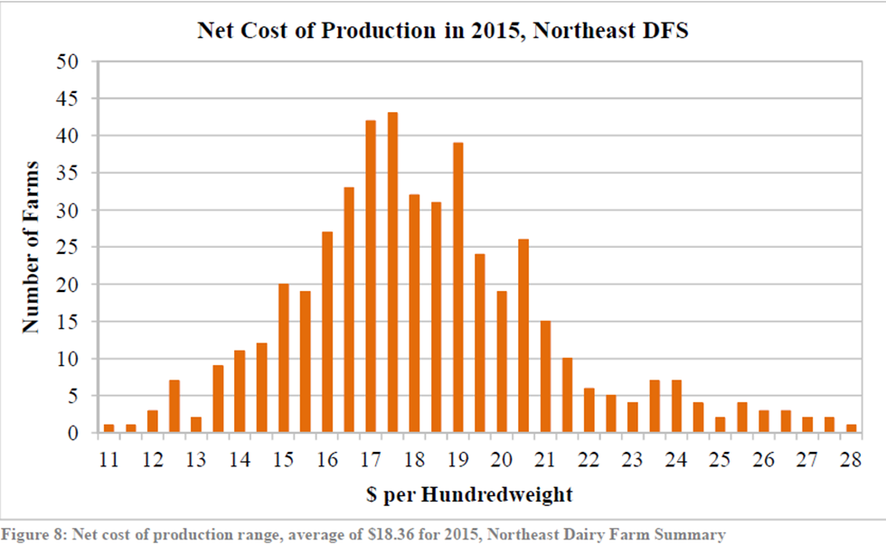
Pennsylvania has higher average cost of production wide range between highest and lowest cop
 | Average | Top 25 % | Middle 50 % | Bottom 25 %
Gross Milk Price | $17.31 | $17.80 | $17.24 | $17.19
Net Cost of Production | $18.71 | $16.19 | $18.35 | $21.79
Net Income | ($1.40) | $1.61 | ($1.11) | ($4.61)
2018 Data from Farm Credit:
Difference Between Top 25% and
Bottom 25% Is Nearly $6 Per
Every One Hundred Pounds Produced.
Wide Range of Cost of Productions on Northeast US Farms:
From $11.00 per cwt. at low to $28 per cwt. at high

Slide 11
Lack of business planning a challenge
Pennsylvania’s higher cost of production a challenge with milk prices averaging below $18 for past 15 years
  Smaller Farms, Average COP of $18.50 per cwt.
  Higher Land Costs and Environmental Pressure
  Lack of Strong Business Management??
2017 Dairy Farmer Survey shows less than 16 percent have formal business plan, less
than 14 percent are using risk management.
 | 2017 | 2012 | 2008
Have you used a financial consultant or accountant? | 59.3 percent | 62.6 percent | 56.4 percent
Have you developed a written business plan? | 15.8 percent | 15.3 percent | 11.7 percent
Have you developed a formalized succession or transition plan? | 13.2 percent | 12.9 percent | 10.0 percent
Have you used crop insurance? | 23.2 percent | 31.5 percent | 35.0 percent
Have you used risk management other than crop insurance? | 14.3 percent | 10.6 percent | 7.2 percent

Slide 12
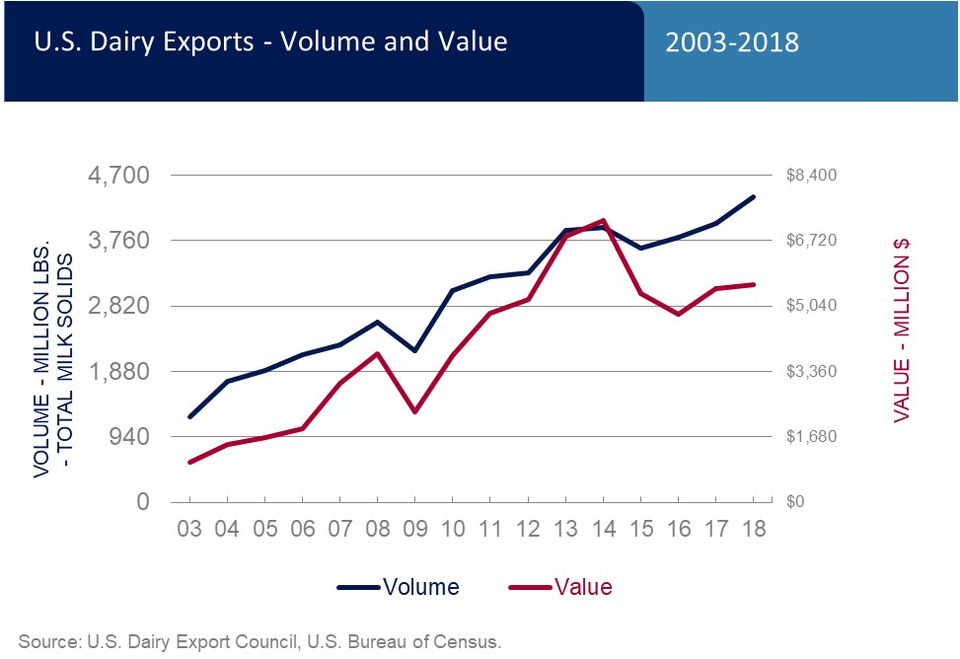
Global marketplace
Pennsylvania Farms Are Operating in Global Marketplace
About 14 Percent of Total Milk Solids Produced in US Exported in 2018
Global Factors Affect Mailbox Price
  Large Supplies in 2017-18 Put Downward Pressure in Price
  Key Dairy Regions Grew During Same Time Period
Market Prices Starting to
Rebound in 2019

Slide 13
Changing marketplace in northeast
Less Milk Going Into Fluid Putting Downward Pressure on Class I
Class II (yogurt) production has declined in the Northeast compared to 3 years ago
More Milk Going Into Class III & IV,
Lowest Priced Classes of Milk
Putting Downward Pressure on “Basis”
or Difference Between PA and US Price
Notes:
Class IV – over 400 million pounds, nearly 19 % of the pool volume – the average percentage utilization of the pool for milk going to Class IV for the prior 14 years was 10.7%. Will this continue, is this a short term blip due to producers responding to last year’s record prices? Hard to tell – but it does factor into possible discussions about things like shipping percents.

Slide 14
Changing marketplace in northeast
Changing Class I Utilization Shrinking Basis Between Pennsylvania Mailbox Prices and
Class III Price.
Changing Processing Needs Causing Short-term Balancing Challenges
Notes:
Class IV – over 400 million pounds, nearly 19 % of the pool volume – the average percentage utilization of the pool for milk going to Class IV for the prior 14 years was 10.7%. Will this continue, is this a short term blip due to producers responding to last year’s record prices? Hard to tell – but it does factor into possible discussions about things like shipping percents.

Slide 15
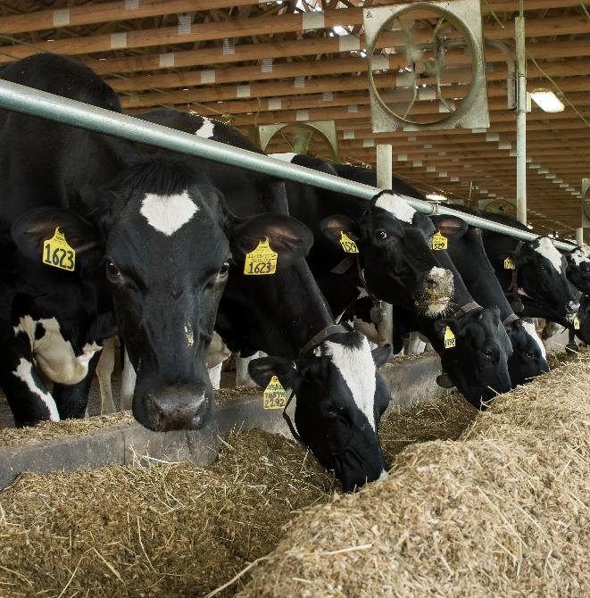
Milk basis has eroded in Pennsylvania
Milk “Basis” Defined as Difference Between Price Dairy Farmers Receives in Mailbox and Class III Milk Price Announced by Market
Pennsylvania Dairy Farmers Have Historically Had a Very High Basis and a Higher Average Milk Price Than Almost Every Other Region in the US
Over Past Ten Years, Basis Has Eroded at Least $1 or More on Most Farms
On Average Dairy Farm with 80 Cows Producing 70 Pounds per Cow -- More Than $20,000 Difference Annually Without That Basis

Slide 16
The Good News

Slide 17
Milk Prices Are Beginning to Rebound After
Three Years of Below Breakeven Levels
2018
Class III price averaged $14.59/cwt
1st Half averaged $14.35/cwt
2018
Class IV price averaged $14.23/cwt
1st Half averaged $13.67/cwt
2019
Class III average* = $16.89/cwt
H1-2019 =$15.25 ($0.90/cwt higher than H1-2018)
H2-2019 price* = $18.54/cwt ($3.95/cwt higher than 2018)
2019
Class IV average* = $16.32/cwt
H1-2019 = $15.98/cwt
($2.31/cwt more than H1-2018)
H2-2019 price* = $16.66/cwt
($2.99/cwt more than 2018)
*Includes November and December Class III and Class IV Futures Prices.

Slide 18
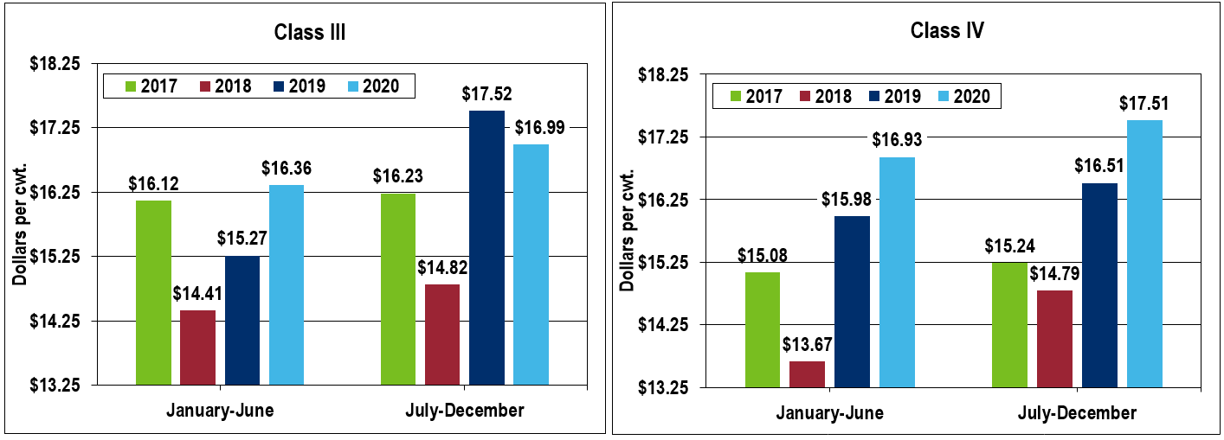
Futures markets are continuing to project recovery
Source: USDA announced prices January 2017-August 2019, CME Group futures markets 9/6/2019

Slide 19
New Farm Safety Net IS Also Providing Better Protection
Dairy Margin Coverage Authorized Under 2018 Farm Bill
Coverage Level of Up to $9.50 Per Cwt.
Higher Than Previous Program, Would Have Protected PA Farms Against Lows in 2015 – 2018
Tailored to Farms Under 250 Cows

Slide 20

BUT, Concerns Remain on how farmers are managing their risks
New Dairy Margin Coverage Program Offers Good Protection, Guaranteed Payout in 2019
Still Pennsylvania Fell Behind National Numbers
  37 Percent of Farms in PA Vs. 62 Percent of Farms in US
  74 Percent of Milk in PA Vs. 82 Percent of Milk in US
Need to Encourage More Farms To Access
Other Programs Offer Additional Protection
  Dairy Revenue Protection
  Market-Based Risk Management Options

Slide 21
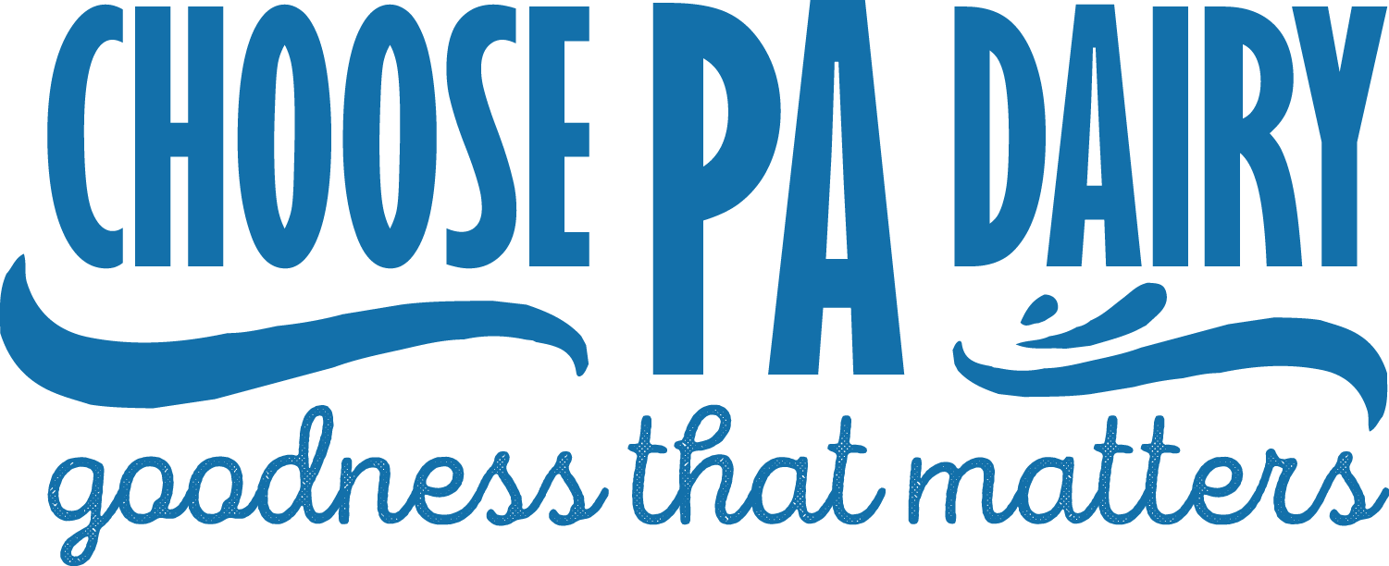
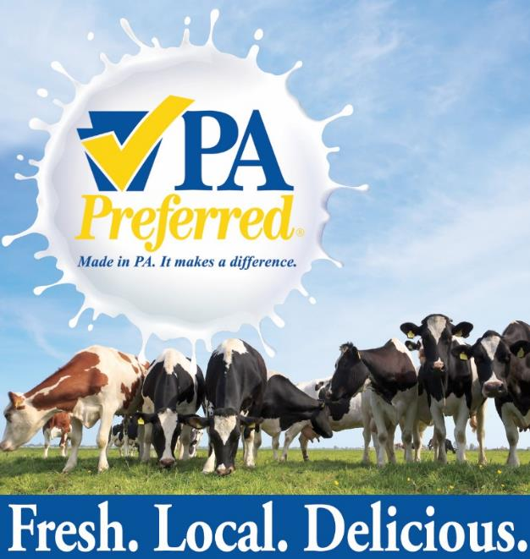
How the Pennsylvania Farm Bill Helps
Pennsylvania Dairy Investment Program: $5 million for research and development, organic transition assistance, value-added processing, and marketing grants in support of dairy industry.
Pennsylvania Ag Business Development Center: $2 million to help farmers create a business plan, transition plan, or succession plan to ensure the best chance of success.
Resource Enhancement and Protection Tax Credits: expanded by $3 million, to increase the lifetime cap and increase availability of REAP tax credits for conservation improvements.
PA Preferred Program: $1 million to support the overall PA Preferred program and to bolster enrollment in the Homegrown by Heroes Program.
PA Preferred Organic Initiative: $1.6 million to make Pennsylvania the nation’s leading organic state by further enhancing the growth of the organic industry.

Slide 22
Dairy In Pennsylvania, To Summarize:
What’s It Worth: Dairy Is A Major Contributor to the Commonwealth In Terms of Local Quality Products, Good Jobs, Valuable Economic Revenue and Wide Open Spaces
What’s It Look Like: Our Dairy Farms Are Generational Businesses, Traditionally Smaller Than Average US Farms, With Higher Cost of Production Than In Other Regions of US
What’s The Challenge: Dairy Farm Families In Pennsylvania Must Become More Competitive And Lower Their Cost of Production, But Are Slow to Utilize Resources To Do So
What’s Happening In Market: Pennsylvania Is Competing On Global Market, And Northeast Region Is Changing With Less Milk Going Into Fluid Milk Than Ever Before. That Changes The Price The Farmer Receives.
What’s The Good News: New Programs Through The Farm Bill Offer A Stronger Safety Net, Particularly for Farms In Pennsylvania, And Milk Prices Are Starting To Rebound in 2019.

